Slide 1
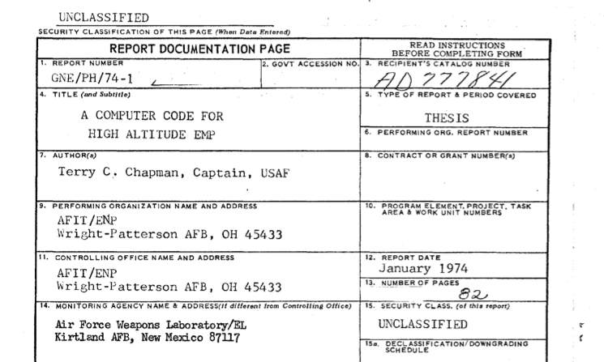
Chapman's Master Thesis

Slide 2
Roadmap
Goals
Identify missing pieces
Recreate output in thesis
Create baseline
Process
Status
Compiles will gfortran in Linux environment
Runs on guessed input file
Produces output and does not crash

Slide 3
Goals
Identify missing pieces
Recreate output in thesis
Create baseline

Slide 4
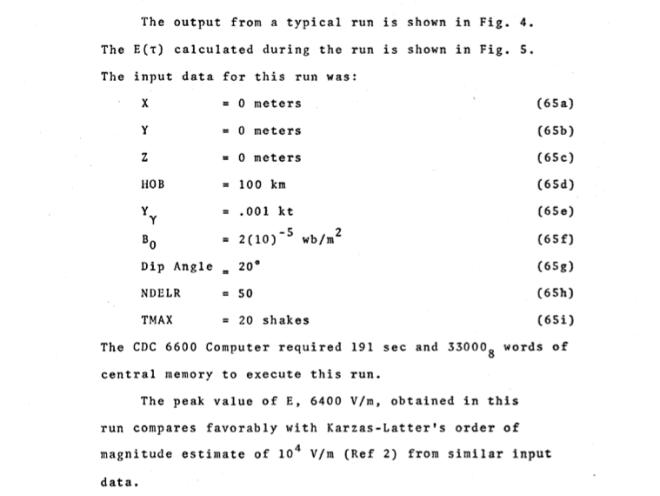

Slide 5
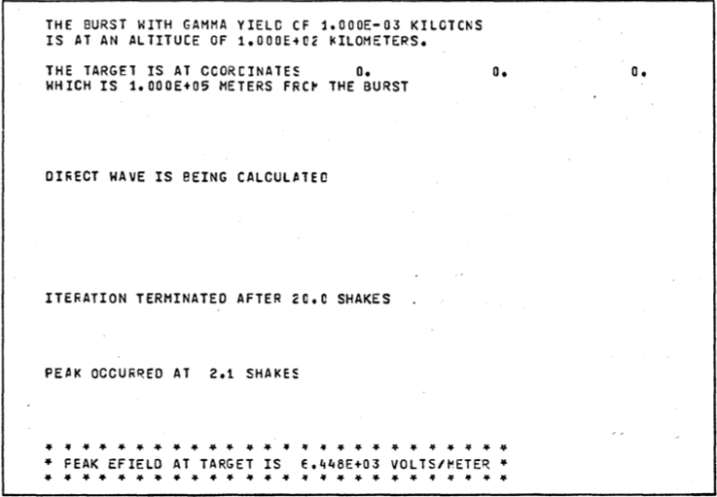

Slide 6
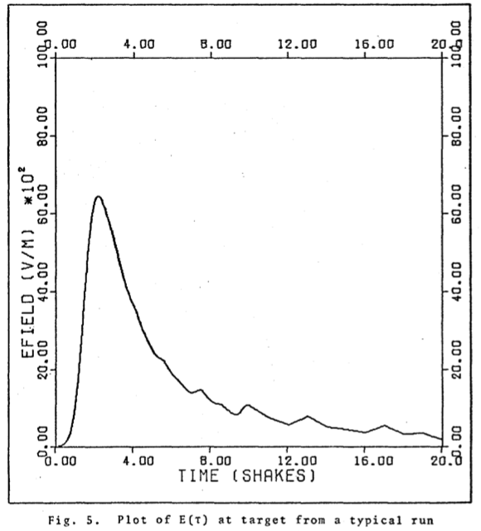

Slide 7
Process
OCR FORTRAN program in thesis
Change code from gfortran compiler
Correct OCR errors
Exclude Plotting code
Compile program
Identify needed inputs
Run program
Compare output with known output

Slide 8
OCR
Extract individual code pages from thesis
Use Free Online OCR Service
https://onlineocr.net

Slide 9
FORTRAN dialect differences
OUT changed to OUX
TIME changed to TIMX
DATA
DATA (C=3.0E8),(RMLC=12.56637E-7)
DATA C/3.0E8/,RMLC/12.56637E-7/
Multi statement line
DO 21 1=1,190 $ T=1+(1.E-9)*DT $ TIME(I)=1·(1.E8)

Slide 10
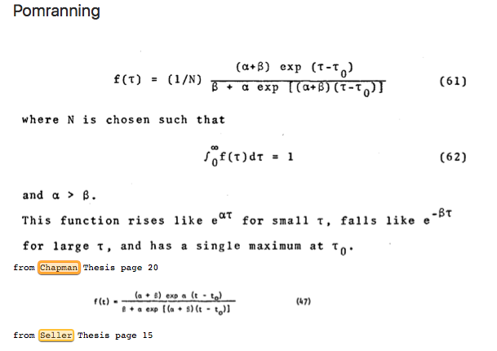

Slide 11
Correct in FOFT(T)
FUNCTION FOFT(T) FOFT1010
C FOFT1020
C F(T) IS THE POMRANNING MODEL FOR TIME DEPENDENCE FOFT1030
C OF NUCLEAR WEAPON YIELD IN RETARDED TIME FOFT1040
INTEGER OUX FOFT1050
COMMON OUX,AP,BP,RNP,TOP FOFT1060
TSHAKE=1.E8*T FOFT1070
DENOM=(BP+AP*EXP((AP+BP)*(TSHAKE-TOP)))*RNP FOFT1080
FOFT=(AP+BP)*EXP(AP*(TSHAKE-TOP))/DENOM FOFT1090
RETURN FOFT1100
END FOFT1101

Slide 12
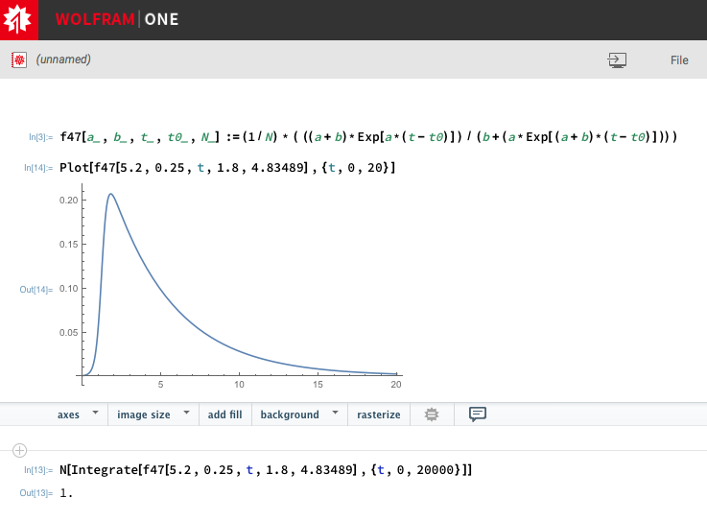
wolframcloud.com

Slide 13
wolframcloud.com
f47[a_,b_,t_,t0_,N_] :=
(1/N) * ( ((a+b)*Exp[a*(t-t0)]) / (b+(a*Exp[(a+b)*(t-t0)])) )
Plot[f47[5,0.25,t,2.24,1],{t,0,20}]
N[Integrate[f47[5,0.25,t,2.24,4.86205],{t,0,20}]]

Slide 14
Status
Compiles will gfortran in Linux environment
Runs on guessed input file
Produces output and does not crash
Have NOT duplicated PEAK and graph from IN

Slide 15
